Slide 1

Numpy, Pandas, Visualization - Part 6
Concatenate, Join, Merge, Pivot Tables, Cross Tables

Slide 2
DataFrame Concatenation

Slide 3
DataFrame Concatenation
Pandas DataFrames can be concatenated vertically (column-wise) and horizontally (row-wise)
The concat() and append() methods are used to concatenate the DataFrames

Slide 4
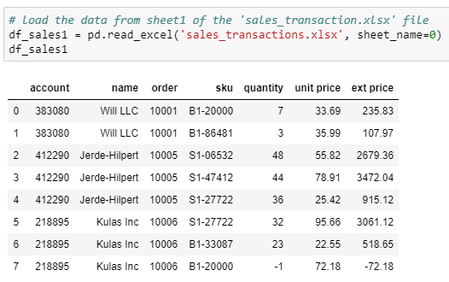
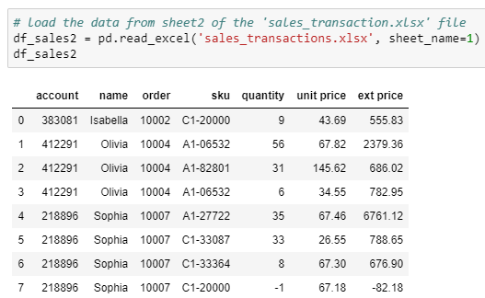
DataFrame Concatenation
Use these following DataFrames for the study:
Sales details of company A
Sales details of company B

Slide 5
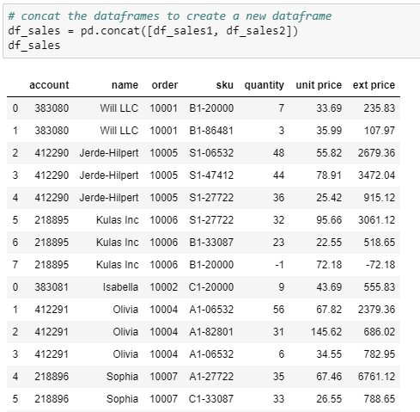
DataFrame Concatenation
We concatenate the two DataFrames using concat() method
By default, the concat() method concatenates along the axis = 0 (vertically)
The concatenation is in the order they are passed in the function
The index numbers of the concatenated DataFrame are of the actual DataFrames

Slide 6
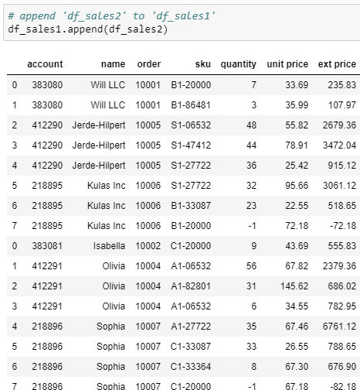
DataFrame Concatenation
The append() method is used append a DataFrame with another
We append the customers data of company ‘B’ to data of company ‘A’

Slide 7
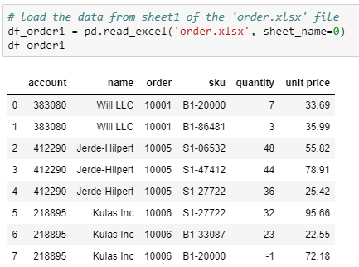
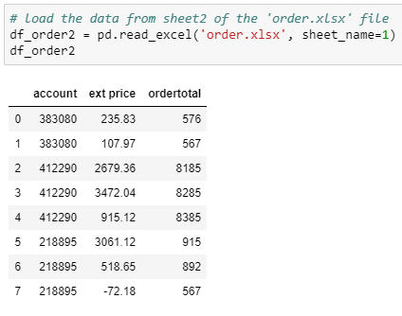
DataFrame Concatenation
Use these DataFrames for the study:
Order details 2
Order details 1

Slide 8
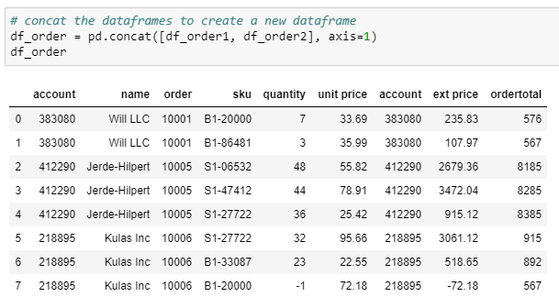
DataFrame Concatenation
The parameter, ‘axis = 1’ concatenates the DataFrames horizontally
The concatenation is in the order they are passed in the function

Slide 9
Append vs. Concat
concat() method | append() method
Concatenates multiple DataFrames simultaneously | Returns an error if we try to concatenate more than two DataFrames simultaneously

Slide 10
DataFrame Joins

Slide 11
DataFrame Joins
The join() method combines the DataFrame rows from one or more tables based on key or index column
Index of the first DataFrame should match to one of the column in the second DataFrame

Slide 12
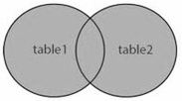
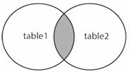
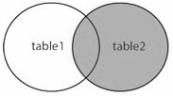
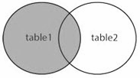
Types of join
The join types can be specified using the parameter, ‘how’
how = ‘Type’ | Description
outer | Use union of index (or column) observed in both DataFrames
inner | Use intersection of index (or column) observed in both DataFrames
right | Use only the index found in the right DataFrame
left | Use only the index (or column) found in the left DataFrame
If the type is not specified, by default it is ‘left’

Slide 13
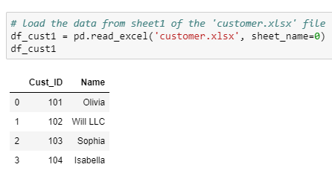
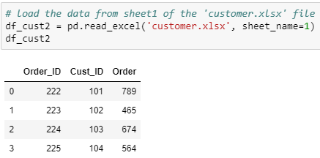
DataFrame Joins
Consider the following DataFrames for the study:
Customer details
Order details

Slide 14
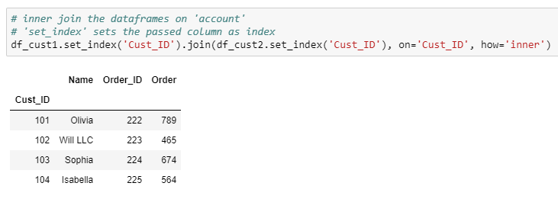
DataFrame Joins - Inner Join
Join the DataFrames to get the order details along with the customer information
Merge includes the common IDs in both the DataFrames
Merge on ‘Cust_ID’

Slide 15
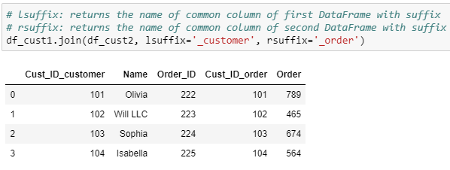
DataFrame Joins using Index
Resultant DataFrame includes rows from both the DataFrames with same index as of ‘df_cust1’

Slide 16
DataFrame Merge

Slide 17
DataFrame Merge
The merge() method concatenates the DataFrames based on one or more keys
If the column for join is not specified, the merge() method uses the overlapping column names as the keys

Slide 18
Types of merge
The merge types can be specified using the parameter, ‘how’
how = ‘Type’ | Description
outer | Use union of keys observed in both DataFrames
inner | Use intersection of keys observed in both DataFrames
right | Use only the keys found in the right DataFrame
left | Use only the keys found in the left DataFrame
By default the type is ‘inner’

Slide 19
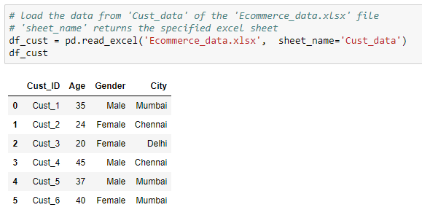
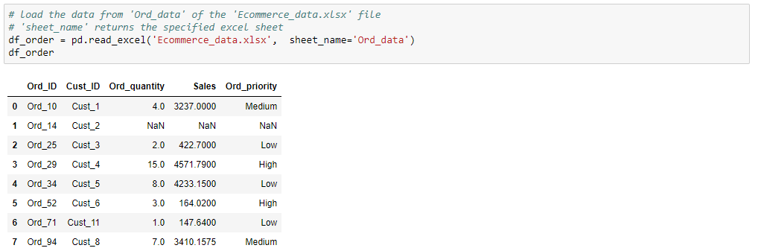
DataFrame Merge
Use the following DataFrames for the study:
Customer details
Order details

Slide 20
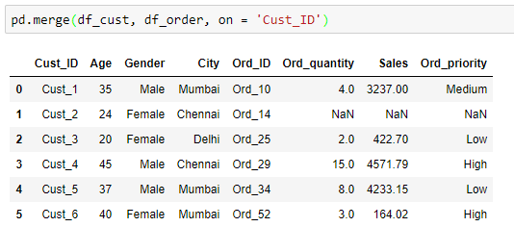
DataFrame Merge - Inner Merge
Merging DataFrames on common customer IDs
Merge on ‘Cust_ID’
Merge includes the common IDs in both the DataFrames
NaNs are printed where order details are not available

Slide 21
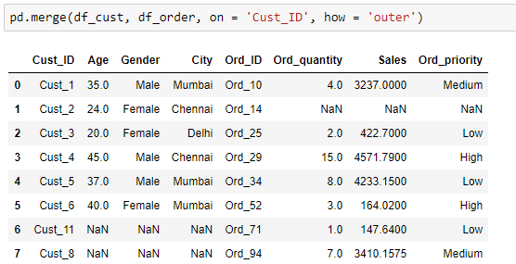
DataFrame Merge - Outer Merge
Merge on ‘Cust_ID’
Outer merge includes the IDs in both DataFrames
NaNs are printed where order details are not available
NaNs are printed where customer details are not available

Slide 22
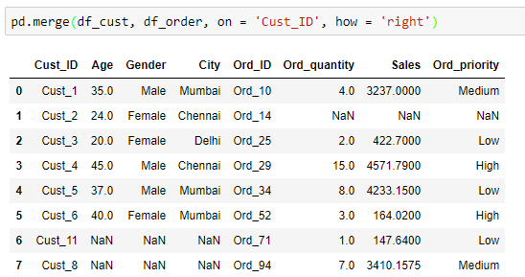
DataFrame Merge - Right merge
Merge on ‘Cust_ID’
Merge includes all the IDs in ‘df_order’
NaNs are printed where order details are not available
NaNs are printed where customer details are not available

Slide 23
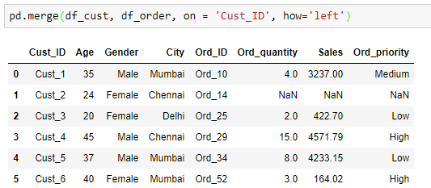
DataFrame Merge - Left merge
Merge on ‘Cust_ID’
Merge includes all the IDs in ‘df_cust’
NaNs are printed where order details are not available

Slide 24
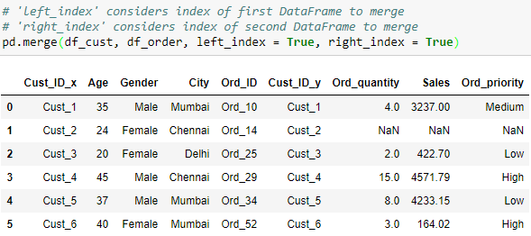
DataFrame Merge using index
Merged DataFrame has the number of rows equal to that of the minimum of both the DataFrames
It includes rows from both DataFrames having same index
This method is useful, only if the record have same index in both the DataFrames

Slide 25
Merge vs. Join
Merge | Join
Joins one or more columns of the second DataFrame | Joins by the index of the second DataFrame
By default, performs ‘inner’ merge | By default, performs ‘Left’ join
Returns error if one tries to merge more than two DataFrames simultaneously | Joins multiple DataFrames by index

Slide 26
Reshaping DataFrame

Slide 27
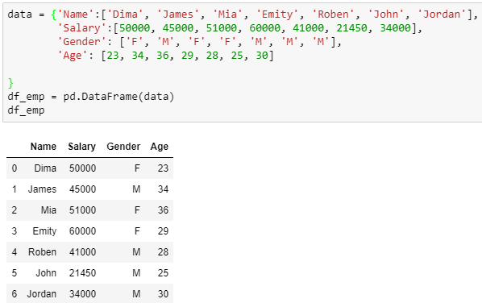
Reshaping DataFrame
Use the following DataFrame for the study:

Slide 28
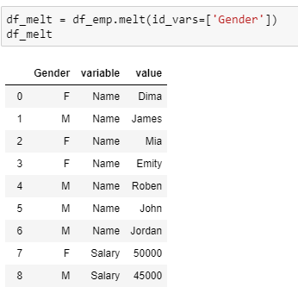
Reshaping DataFrame
The melt() method is used to change the DataFrame format from wide to long
The column ‘variable’ contains all the columns except the identifiers and ‘value’ contains the values of corresponding column
You can pass list of columns as identifiers

Slide 29
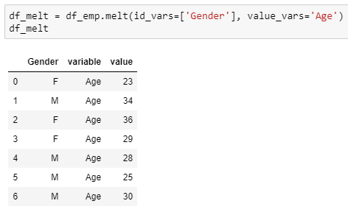
Reshaping DataFrame
Assign the variables to the parameter, ‘value_vars’ to get the corresponding values for specified identifiers
Pass the column names to return the corresponding values

Slide 30
Pivot Tables

Slide 31
Pivot tables
DataFrame like structure
Used to display the data for the specified columns and index

Slide 32
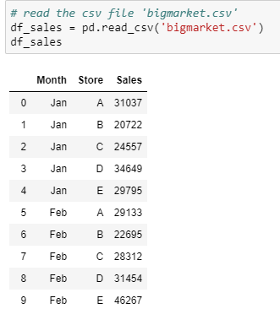
Read the DataFrame
Use the following DataFrame to create a pivot table

Slide 33
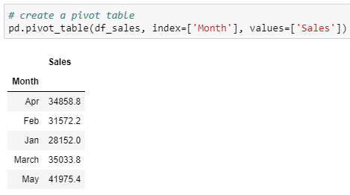
Create a pivot table
The pivot_table() method generates a pivot table for the given index
By default, the aggregate function is ‘mean’, which aggregates the columns passed in the parameter, ‘values’
Pass the columns to aggregate
Average sales per month

Slide 34
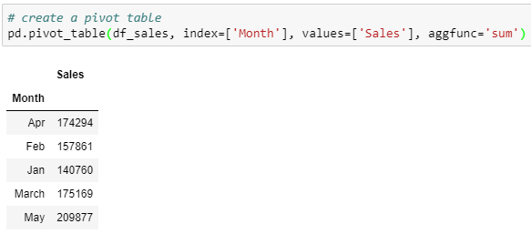
Create a pivot table
Returns the sum of values
Sum of sales per month

Slide 35
Cross Tables

Slide 36
Cross Tables
Similar to pivot tables
Computes a cross tabulation of two or more factors

Slide 37
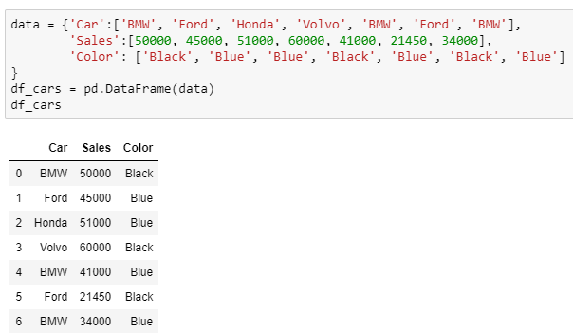
Cross Tables
Use the following DataFrame to create a cross table

Slide 38
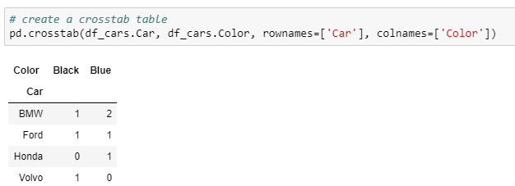
Creating Cross Table
Find the color-wise car count using the crosstab() method
Pass the row label
Pass the column label
By default, the crosstab() method returns the frequency table of the variables

Slide 39
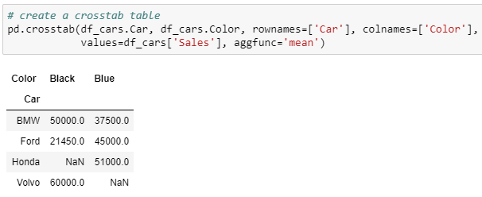
Creating Cross Table
Find the color-wise distribution of sales for different cars
Values to be aggregated
Function to aggregate the values

Slide 40
THANK YOU
Presenter’s Name
Contact Us
support@knowledgehut.com
Presenter’s Designation

